Slide 1
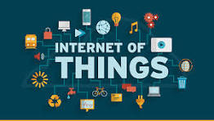
Internet of Things- Enabling Technologies & Logical Design
Eng. PN Karunanayake

Slide 2
IoT Enabling Technologies
Wireless Sensor Network(WSN):
Comprises distributed devices with sensors that are used to monitor the environmental and physical conditions.
Examples :
Weather Monitoring System: in which nodes collect temperature, humidity, and other data, which is aggregated and analyzed.
Indoor air quality monitoring systems: collect data on the indoor air quality and concentration of various gases.
Soil Moisture Monitoring Systems: to monitor soil moisture at various locations.
Surveillance Systems: use WSNs for collecting surveillance data(motion data detection).
Smart Grids: use WSNs for monitoring grids at various points.

Slide 3
IoT Enabling Technologies
Cloud Computing:
Services are offered to users in different forms.
Infrastructure-as-a-service(IaaS):provides users the ability to provision computing and storage resources. These resources are provided to the users as a virtual machine instance and virtual storage.
Platform-as-a-Service(PaaS): provides users the ability to develop and deploy applications in cloud using the development tools, APIs, software libraries, and services provided by the cloud service provider.
Software-as-a-Service(SaaS): provides the user with a complete software application or the user interface to the application itself.

Slide 4
IoT Enabling Technologies
Big Data Analytics:
Some examples of big data generated by IoT are:
Sensor data generated by IoT systems.
Machine sensor data collected from sensors established in industrial and energy systems.
Health and fitness data generated IoT devices.
Data generated by IoT systems for location and tracking vehicles.
Data generated by retail inventory monitoring systems.

Slide 5
IoT Enabling Technologies
Communication Protocols:
Form the back-bone of IoT systems and enable network connectivity and coupling to applications.
Allow devices to exchange data over network.
Define the exchange formats, data encoding addressing schemes for device and routing of packets from source to destination.
It includes sequence control, flow control and retransmission of lost packets.

Slide 6
IoT Enabling Technologies
Embedded Systems:
Is a computer system that has computer hardware and software embedded to perform specific tasks.
Embedded Systems range from low-cost miniaturized devices such as digital watches to devices such as digital cameras, POS terminals, vending machines, appliances etc.,

Slide 7
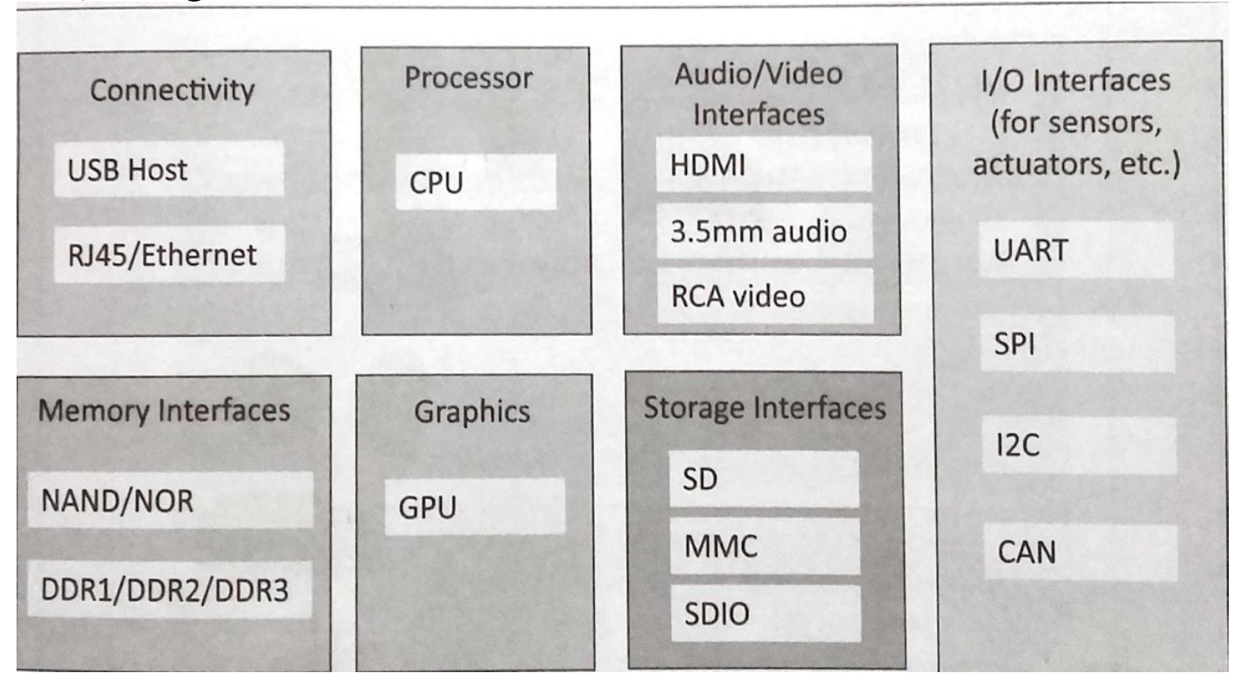
Physical Design Of IoT

Slide 8
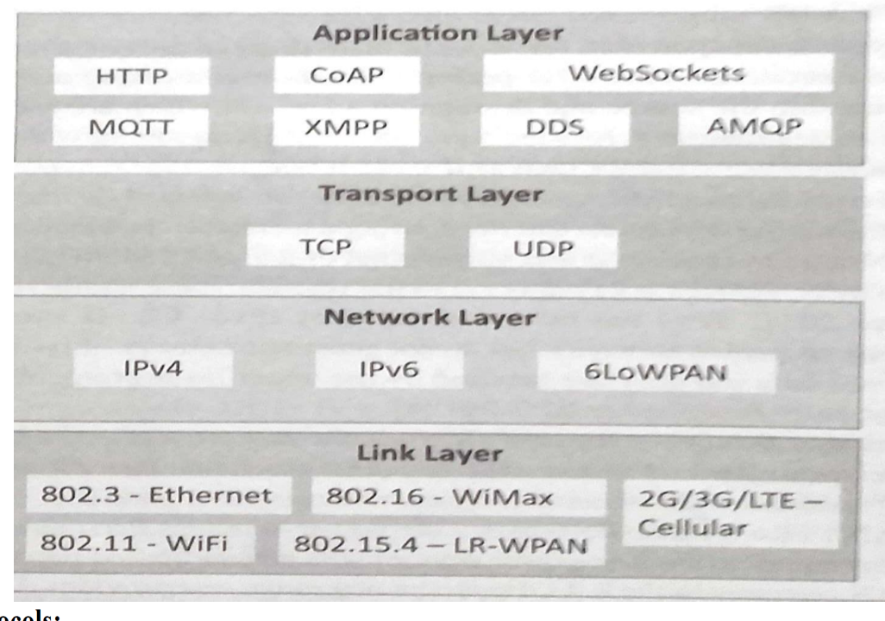
IoT Protocols:
Link Layer : Protocols determine how data is physically sent over the network‘s physical layer or medium. Local network connect to which host is attached. Hosts on the same link exchange data packets over the link layer using link layer protocols. Link layer determines how packets are coded and signalled by the h/w device over the medium to which the host is attached.

Slide 9
Link Layer Protocols
802.3-Ethernet: IEEE802.3 is collection of wired Ethernet standards for the link layer. Eg: 802.3 uses co-axial cable; 802.3i uses copper twisted pair connection; 802.3j uses fiber optic connection; 802.3ae uses Ethernet overfiber.
802.11-WiFi: IEEE802.11 is a collection of wireless LAN(WLAN) communication standards including extensive description of link layer. Eg: 802.11a operates in 5GHz band, 802.11b and 802.11g operates in 2.4GHz band, 802.11n operates in 2.4/5GHz band, 802.11ac operates in 5GHz band, 802.11ad operates in 60Ghzband.
802.16 - WiMax: IEEE802.16 is a collection of wireless broadband standards including exclusive description of link layer. WiMax provide data rates from 1.5 Mb/s to 1Gb/s.
802.15.4-LR-WPAN: IEEE802.15.4 is a collection of standards for low rate wireless personal area network(LR-WPAN). Basis for high level communication protocols such as ZigBee. Provides data rate from 40kb/s to250kb/s.
2G/3G/4G-Mobile Communication: Data rates from 9.6kb/s(2G) to up to100Mb/s(4G).

Slide 10
Transport Layer:
Provides end-to-end message transfer capability independent of the underlying n/w. Set up on connection with ACK as in TCP and without ACK as in UDP. Provides functions such as error control, segmentation, flow control and congestion control.
Protocols:
TCP: Transmission Control Protocol used by web browsers(along with HTTP and HTTPS), email(along with SMTP, FTP). Connection-oriented and stateless protocol. IP Protocol deals with sending packets, and TCP ensures reliable transmission of protocols in order. Avoids n/w congestion and congestion collapse.
UDP: User Datagram Protocol is connectionless protocol. Useful in time-sensitive applications, very small data units to exchange. Transaction-oriented and stateless protocol. Does not provide guaranteed delivery.

Slide 11
Network/Internet Layer: Responsible for sending IP datagrams from source n/w to destination n/w. Performs the host addressing and packet routing. Datagrams contains source and destinationaddress.
Protocols:
IPv4: Internet Protocol version4 is used to identify the devices on a n/w using a hierarchical addressing scheme. 32 bit address. Allows total of 2³²addresses.
IPv6: Internet Protocol version6 uses 128 bit address scheme and allows 2¹²⁸ addresses.
6LOWPAN:(IPv6overLowpowerWirelessPersonalAreaNetwork) operates in 2.4 GHz frequency range and data transfer 250 kb/s.

Slide 12
Application Layer:
Defines how the applications interface with lower layer protocols to send data over the n/w. Enables process-to-process communication using ports.
Protocols:
HTTP: Hyper Text Transfer Protocol that forms foundation of WWW. Follow request- response model Stateless protocol.
CoAP: Constrained Application Protocol for machine-to-machine(M2M) applications with constrained devices, constrained environment and constrained n/w. Uses client- server architecture.
WebSocket: allows full duplex communication over a single socket connection.
MQTT: Message Queue Telemetry Transport is light weight messaging protocol based on publish-subscribe model. Uses client server architecture. Well suited for constrained environment.

Slide 13
Application Layer:
XMPP: Extensible Message and Presence Protocol for real time communication and streaming XML data between network entities. Support client-server and server-server communication.
DDS: Data Distribution Service is data centric middleware standards for device-to-device or machine-to-machine communication. Uses publish-subscribe model.
AMQP: Advanced Message Queuing Protocol is open application layer protocol for business messaging. Supports both point-to-point and publish-subscribe model.

Slide 14
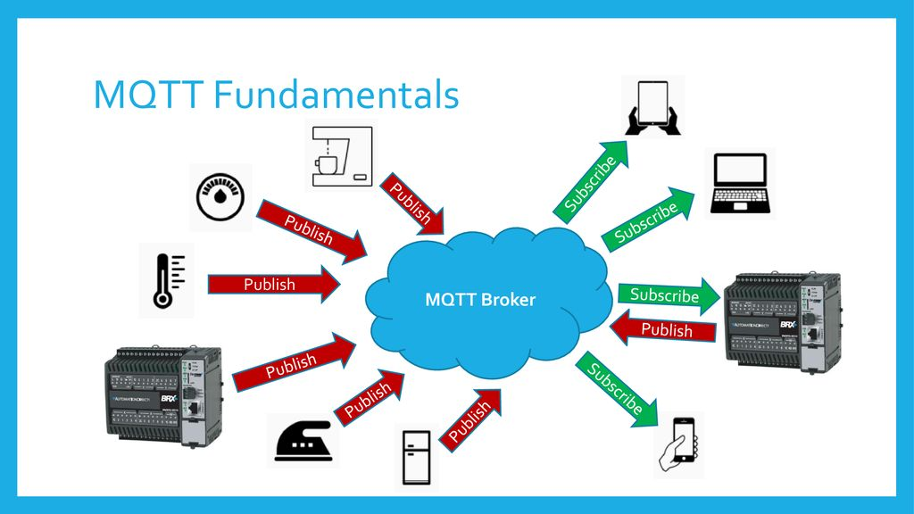
Notes:
a messaging protocol used in many IoT applications. enables real-time and asynchronous device communication, while conserving power and bandwidth.

Slide 15
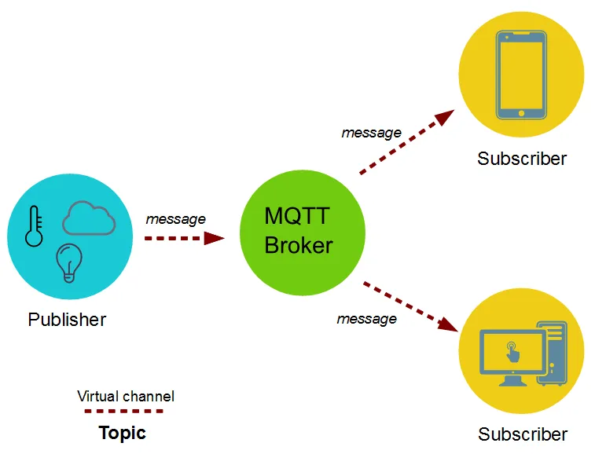

Slide 16
LOGICAL DESIGN of IoT
IoT Functional Blocks
IoT Communication Models
IoT Comm. APIs

Slide 17
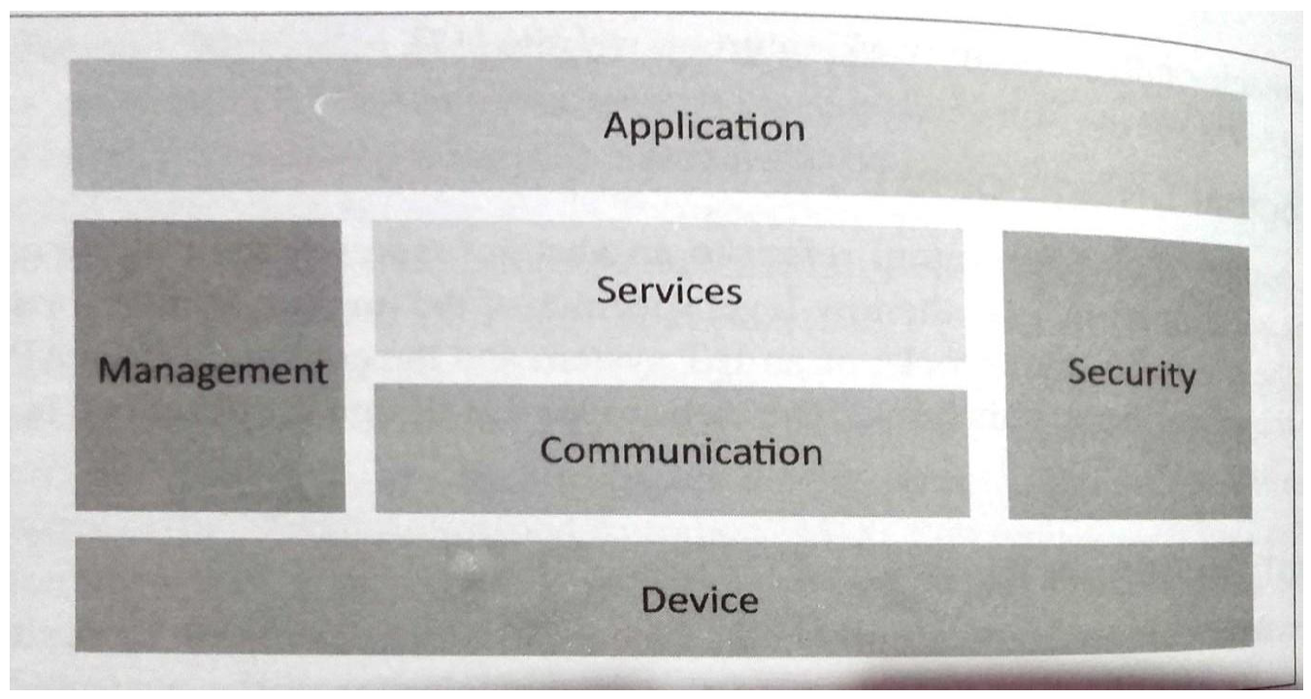
IoT Functional Blocks:
Provide the system the capabilities for identification, sensing, actuation, communication and management.

Slide 18
Device: An IoT system comprises of devices that provide sensing, actuation, monitoring and control functions.
Communication: handles the communication for IoT system.
Services: for device monitoring, device control services, data publishing services and services for device discovery.
Management: Provides various functions to govern the IoT system.
Security: Secures IoT system and priority functions such as authentication, authorization, message and context integrity and data security.
Application: IoT application provide an interface that the users can use to control and monitor various aspects of IoT system.

Slide 19
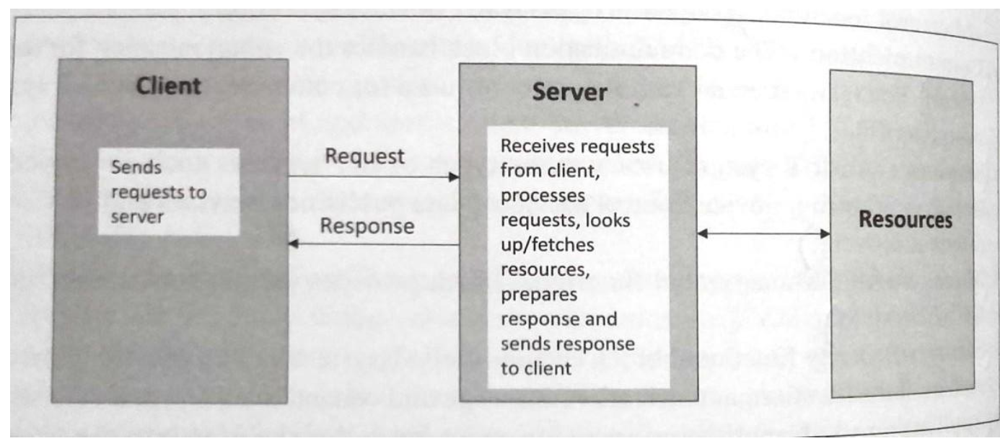
IoT Communication Models:
In which the client sends request to the server and the server replies to requests. Is a stateless communication model and each request-response pair is independent of others.
Request-Response Model:

Slide 20
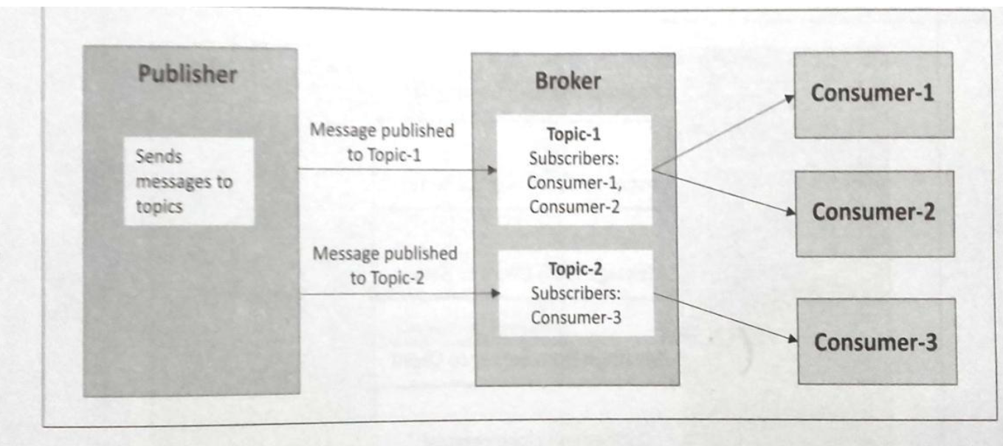
IoT Communication Models:
Involves publishers, brokers and consumers. Publishers are source of data. Publishers send data to the topics which are managed by the broker. Publishers are not aware of the consumers. Consumers subscribe to the topics which are managed by the broker. When the broker receives data for a topic from the publisher, it sends the data to all the subscribed consumers.
Publish-Subscibe Model:

Slide 21
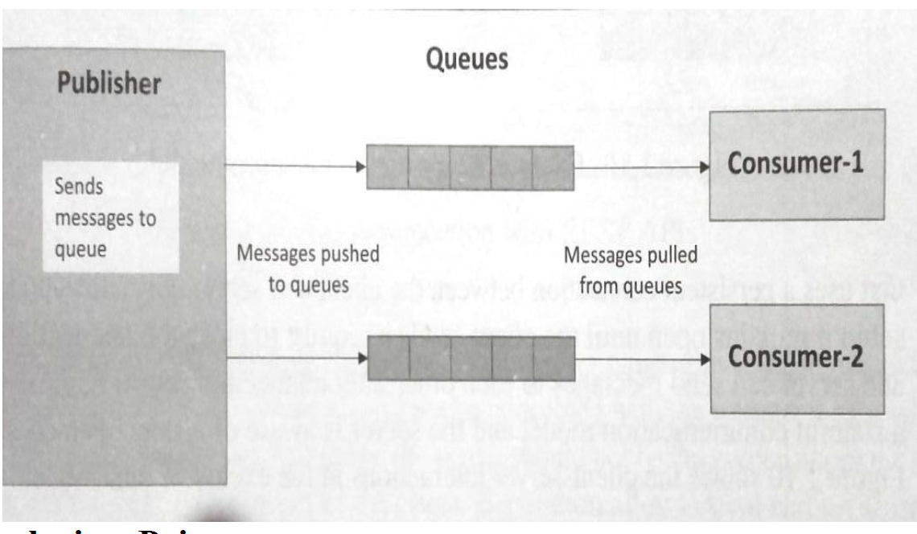
IoT Communication Models:
in which data producers push data to queues and consumers pull data from the queues. Producers do not need to aware of the consumers. Queues help in decoupling the message between the producers and consumers.
Push-Pull Model:

Slide 22
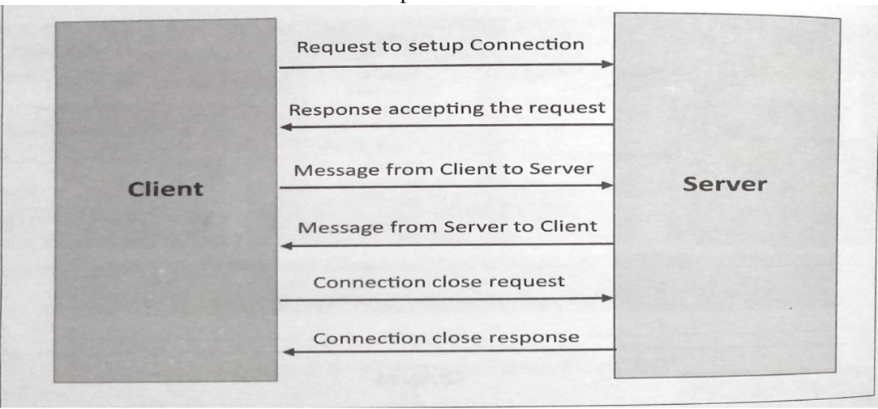
IoT Communication Models:
bi-directional, fully duplex communication model that uses a persistent connection between the client and server. Once connection is set up it remains open until the client send a request to close the connection. Is a stateful communication model and server is aware of all the open connections.
Exclusive Pair:

Slide 23
IoT Communication APIs
REST based communication APIs(Request-Response Based Model)
Representational State Transfer(REST) is a set of architectural principles by which we can design web services and web APIs that focus on a system‘s resources and have resource states are addressed and transferred.
WebSocket based Communication APIs(Exclusive Pair Based Model)

Slide 24
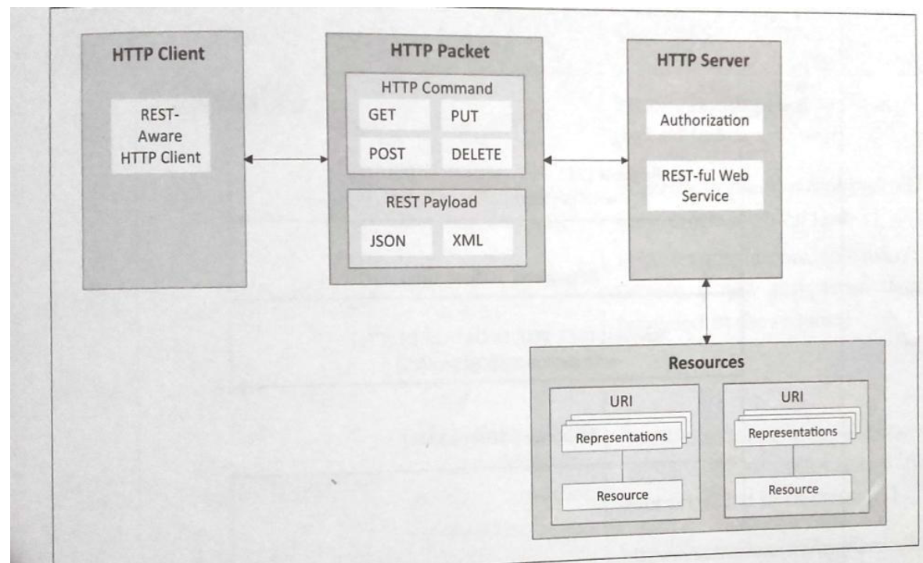
The REST architectural constraints: Fig. shows communication between client server with REST APIs.

Slide 25
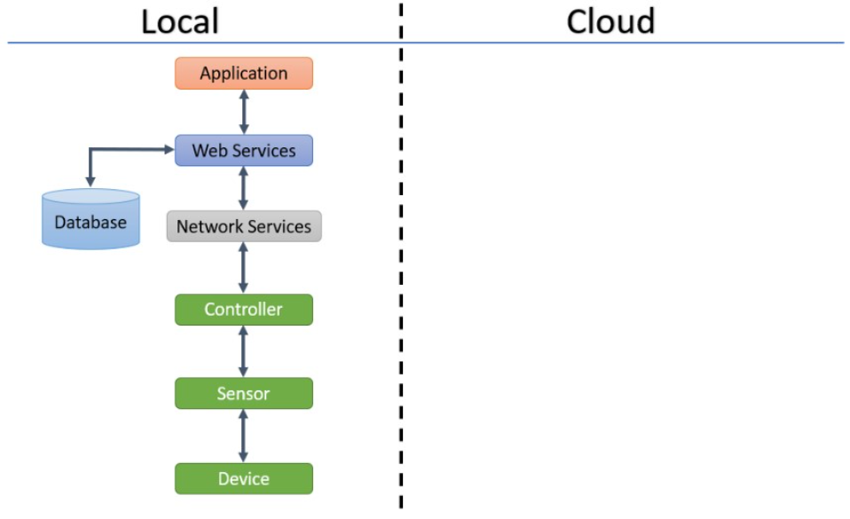
IoT Levels and Deployment Templates
IoT Level 1:
System has a single node that performs sensing and/or actuation, stores data, performs analysis and host the application as shown in fig. Suitable for modeling low cost and low complexity solutions where the data involved is not big and analysis requirement are not computationally intensive. An e.g., of IoT Level1 is Home automation.
Notes:
In this level all the components are deployed locally. There is no any cloud or external network involved in the process. Sensors, routers, cloud components, application etc. all are at the user’s end. This standard is good for those ecosystems where data is neither big nor varying. A uniform stream of data is coming from a pre-set group of sensors and that is all happening in a simple way. An example of Level 1 IoT is a smart home.

Slide 26
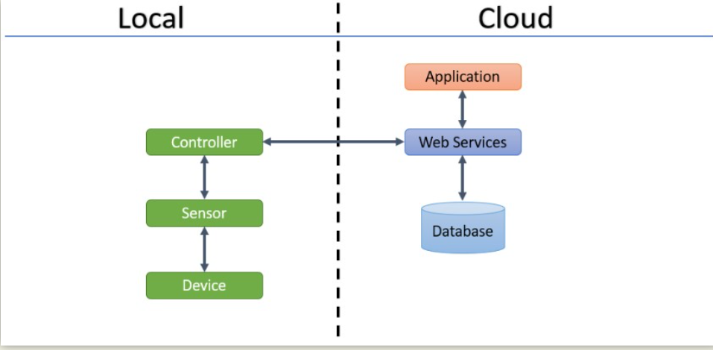
IoT Levels and Deployment Templates
IoT Level 2:
Has a single node that performs sensing and/or actuating and local analysis as shown in fig. Data is stored in cloud and application is usually cloud based. Level2 IoT systems are suitable for solutions where data are involved is big, however, the primary analysis requirement is not computationally intensive and can be done locally itself. An e,g., of Level2 IoT system for Smart Irrigation.
Notes:
all the components are deployed locally except the servers. There is a cloud or an external network involved in the process. The cloud part is having the servers configured for the purpose of storage and analysis. This standard is good for those ecosystems where data is big. A huge amount of data is coming from many components in the ecosystem and that too on a rapid speed.

Slide 27
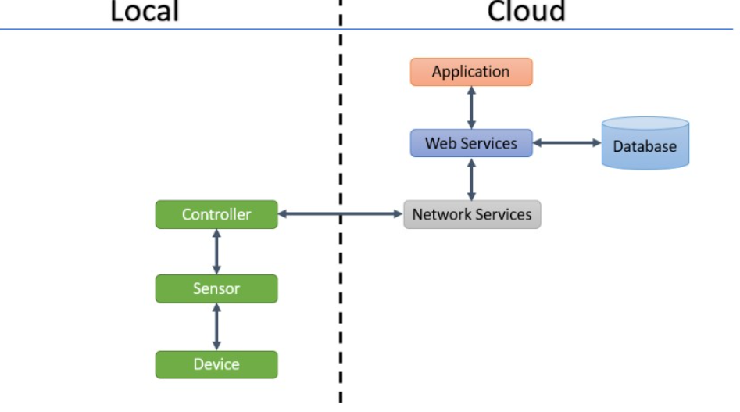
IoT Levels and Deployment Templates
IoT Level 3:
System has a single node. Data is stored and analysed in the cloud application is cloud based as shown in fig. Level3 IoT systems are suitable for solutions where the data involved is big and analysis requirements are computationally intensive. An example of IoT level3 system for tracking package handling.
Notes:
all the components are deployed locally except the servers and the network connectivity part. There is a cloud or an external network involved in the process.
At the user’s end there are only sensors and application. The cloud part is having the essential networks for connectivity and servers configured for the purpose of storage and analysis. This standard is good for those ecosystems where data is big and varying. A huge amount of data is coming from many components deployed in many ecosystems and that too on a rapid speed.

Slide 28
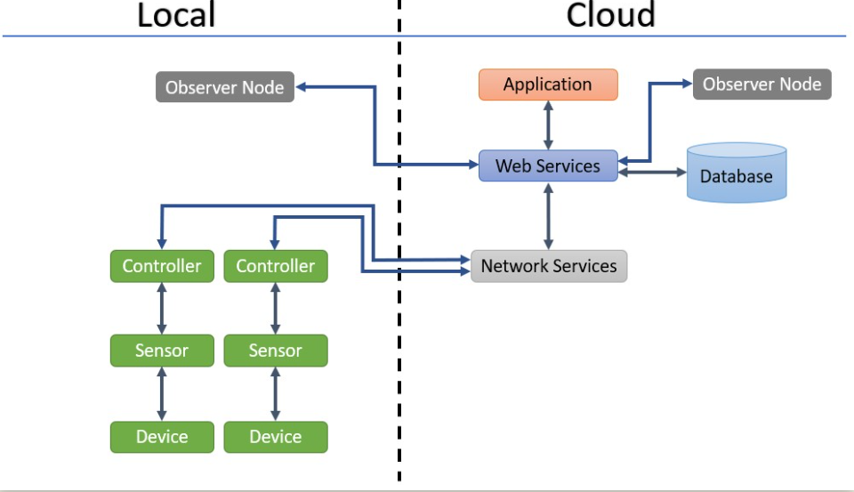
IoT Levels and Deployment Templates
IoT Level 4:
System has multiple nodes that perform local analysis. Data is stored in the cloud and application is cloud based as shown in fig. Level4 contains local and cloud based observer nodes which can subscribe to and receive information collected in the cloud from IoT devices. An example of a Level4 IoT system for Noise Monitoring.
Notes:
all the components are deployed locally except the servers and the network connectivity part. In some cases, sensors are also in the cloud.
At the user’s end there is only the application. The cloud part is having the essential networks for connectivity and servers configured for the purpose of storage and analysis. This standard is good for those ecosystems where data is big, varying and is coming from mobile sources.
An example of Level 4 IoT is a courier tracking system.

Slide 29
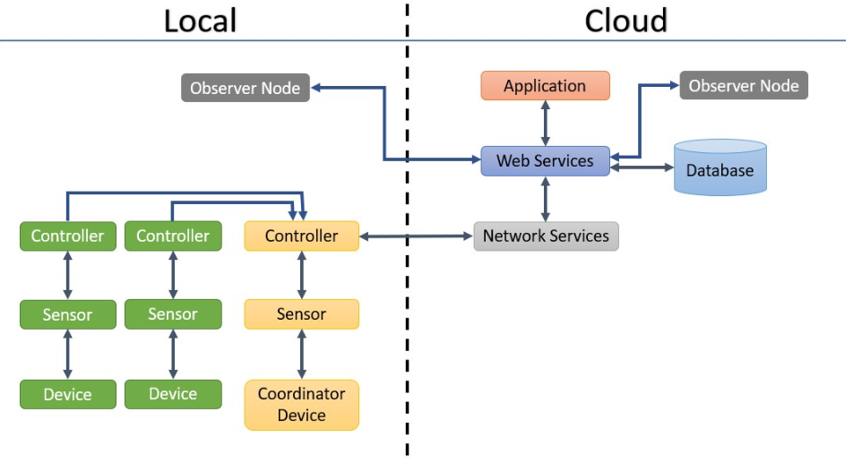
IoT Levels and Deployment Templates
IoT Level 5:
System has multiple end nodes and one coordinator node as shown in fig. The end nodes that perform sensing and/or actuation. Coordinator node collects data from the end nodes and sends to the cloud. Data is stored and analysed in the cloud and application is cloud based. Level5 IoT systems are suitable for solution based on wireless sensor network, in which data involved is big and analysis requirements are computationally intensive. An example of Level5 system for Forest Fire Detection.
Notes:
In level 5 IoT, coordinator devices are also there in the local part of the ecosystem. A coordinator device coordinates a certain set of sensing devices. There is an Observer Node also in the cloud part that observes the entire process.

Slide 30
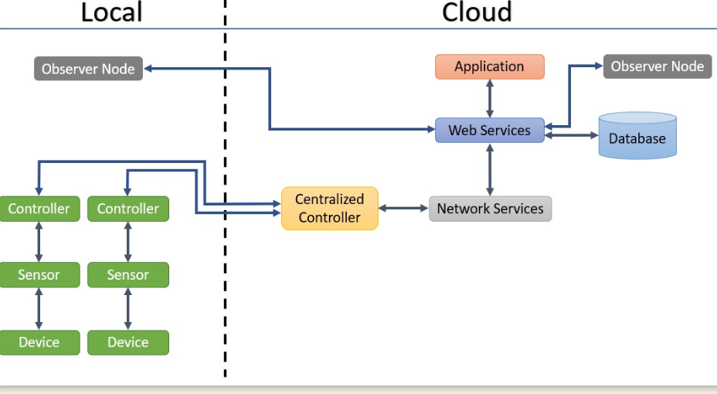
IoT Levels and Deployment Templates
IoT Level 6:
System has multiple independent end nodes that perform sensing and/or actuation and sends data to the cloud. Data is stored in the cloud and application is cloud based as shown in fig. The analytics component analyses the data and stores the result in the cloud data base. The results are visualized with cloud based application. The centralized controller is aware of the status of all the end nodes and sends control commands to nodes. An example of a Level6 IoT system for Weather Monitoring System.
Notes:
n level 6 IoT, coordinator devices are replaced by a single component Centralized Controller and that is there in the cloud part of the ecosystem.

Slide 31
IOT ENABLING TECHNOLOGIES AND LOGICAL DESIGN
NAME: YOUR NAME DATE: AUGUST - 2024

Slide 32
IOT OVERVIEW
INTRODUCTION TO IOT
IMPORTANCE AND GROWTH
TECHNOLOGICAL ADVANCEMENTS
The Internet of Things (IoT) refers to a network of interconnected devices that communicate and share data to enable automation and valuable insights. Its significance lies in transforming industries, enhancing efficiency, and improving decision-making processes.
IoT has witnessed exponential growth, with billions of devices connected globally. Its importance lies in enabling smart homes, cities, healthcare, and industries, revolutionizing the way we interact with technology.
Advancements in sensors, connectivity, and cloud computing have fueled the expansion of IoT, providing seamless data exchange, real-time monitoring, and predictive analytics.

Slide 33
ENABLING TECHNOLOGIES
SENSORS
CONNECTIVITY
CLOUD COMPUTING
Sensors play a crucial role in IoT by collecting data from the environment. They enable monitoring of physical parameters like temperature, pressure, and motion, providing valuable insights for decision-making.
Connectivity technologies such as Wi-Fi, Bluetooth, and cellular networks facilitate seamless communication between IoT devices and the cloud. They ensure data transfer and command execution in real-time.
Cloud computing acts as the backbone of IoT infrastructure, offering scalable storage, processing power, and analysis tools. It enables data hosting, analytics, and remote access to IoT applications.

Slide 34
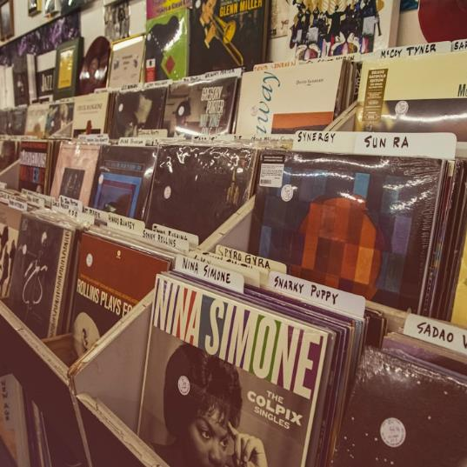

LOGICAL DESIGN PRINCIPLES
OPTIMIZING PERFORMANCE
Effective logical design enhances system performance, minimizes latency, and ensures data integrity. It focuses on interoperability, security, and adaptability to changing requirements.
IMPORTANCE OF DESIGN
Logical design is pivotal in crafting efficient and scalable IoT solutions. It involves structuring data flow, defining communication protocols, and optimizing resource utilization for seamless operation.

Slide 35
IOT ARCHITECTURE
COMPONENT | DESCRIPTION
Sensors | Capture physical data
Gateways | Connect sensors to network
Cloud Platform | Data storage and analytics
Applications | User interface and actions
Networking | Communication between components

Slide 36

SECURITY CONSIDERATIONS
MITIGATION STRATEGIES
Implementing robust encryption, authentication protocols, and regular security updates can mitigate IoT security risks. Awareness, monitoring, and incident response plans are essential for safeguarding IoT ecosystems.
SECURITY CHALLENGES
IoT faces unique security challenges like data breaches, device vulnerabilities, and network attacks. Safeguarding data integrity, privacy, and system resilience is crucial in IoT implementations.

Slide 37
CASE STUDIES
40%
20%
10%
30%
SMART AGRICULTURE
SMART CITIES
INDUSTRIAL AUTOMATION
HEALTHCARE MONITORING
Smart IoT solutions in agriculture have increased crop yields by 40% through precision farming, automated irrigation, and real-time monitoring.
Smart city initiatives powered by IoT technologies have enhanced urban efficiency and sustainability, reducing energy consumption by 20% through smart lighting, waste management, and traffic optimization.
IoT-driven industrial automation solutions have optimized production processes and reduced downtime by 10% by enabling predictive maintenance, remote monitoring, and operational insights.
IoT-enabled healthcare monitoring systems have improved patient care and reduced hospital readmissions by 30% using remote patient monitoring and predictive healthcare analytics.

